Slide 1
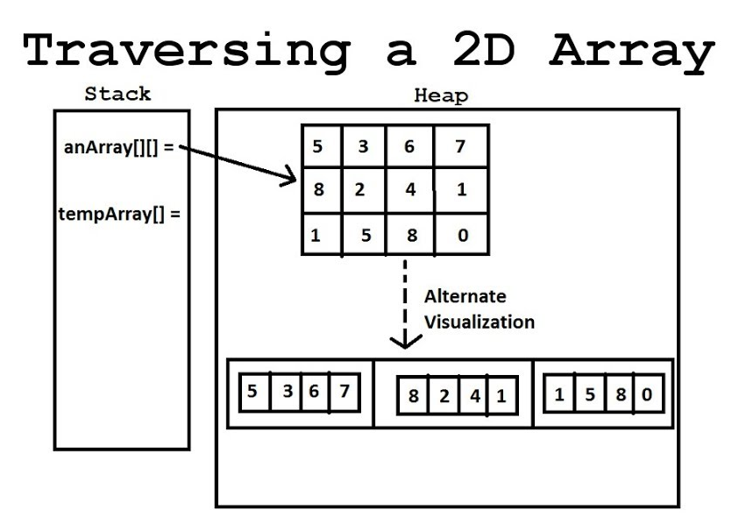
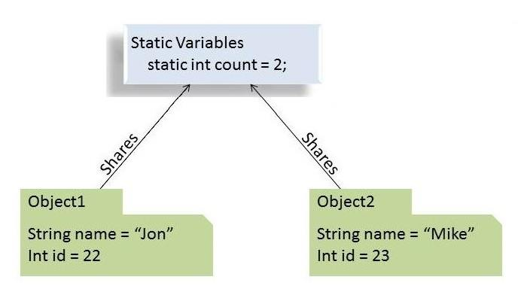

L04 Static Variables and 2D Arrays

Slide 2
Today
Check in:
Git/GitHub and Eclipse -
Were you able to set up?
Do you need help?
GE M01 Part 1 - Any Questions?
GE M01 Part 2 will be posted before next Tuesday
S25_ CS1050 Resources_Spring_2025
Get Set Up
If you don’t have Eclipse working or it is installed on your computer at home, sit with someone that has it working to work in class
Go today’s lecture and open these slides as google slides or powerpoint
Open up your technical document
Open up Eclipse if you are able to or you can use the
Open up github desktop
It is ok if you do not have a computer to bring to class with Eclipse but you should have a computer outside of class you can use that you can install environment tools. Please meet with me if you have questions or need help accessing a computer from home

Slide 3
2D Array (Pre-test Discussion)
Why constants?
final int TABLE_ROW_SIZE = 5;
final int TABLE_COL_SIZE = 6;
int[][] table = new int[TABLE_ROW_SIZE][TABLE_COL_SIZE];
for (int row = 0; row < TABLE_ROW_SIZE; row++)
{
for (int col = 0; col < TABLE_COL_SIZE; col++)
{
table[row][col] = (row + 1) * (col + 1);
}
}
What is this code doing?
What is happening in memory (stack and heap)? What is stored?
What is this code doing?
How have you been doing practicing understanding and creating code for Arrays, Strings, methods and creating your own classes

Slide 4
Tables of Data
 | col[0] | col[1] | col[2] | col[3] | col[3]
row[0] | 1 | 2 | 3 | 4 | 5
row[1] | 2 | 4 | 6 | 8 | 10
row[2] | 3 | 6 | 9 | 12 | 15
row[3] | 4 | 8 | 12 | 16 | 20
row[3] | 5 | 10 | 15 | 20 | 25
table[0][0] = 1 table[0][1] = 2 table[0][2] = 3 table[0][3] = 4 table[0][4] = 5
table[1][0] = 2 table[1][1] = 4 table[1][2] = 6 table[1][3] = 8 table[1][4] = 10
table[2][0] = 3 table[2][1] = 6 table[2][2] = 9 table[2][3] = 12 table[2][4] = 15
table[3][0] = 4 table[3][1] = 8 table[3][2] = 12 table[3][3] = 16 table[3][4] = 20
table[4][0] = 5 table[4][1] = 10 table[4][2] = 15 table[4][3] = 20 table[4][4] = 25

Slide 5
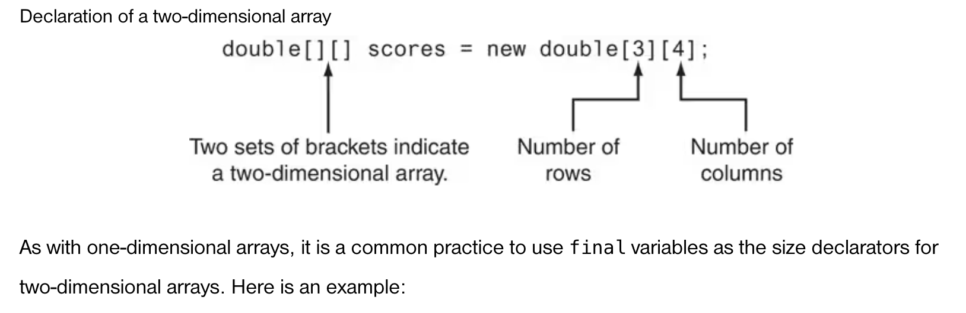
2 Dimensional Arrays
We’ve seen that an array is a container that provides a way to store more than one value
Arrays can have more than one dimension!
One-dimensional arrays – model linear collections of elements
Two-dimensional arrays – model a matrix or a table like a spreadsheet
What are different ways you could initialize a 1 dimensional array?

Slide 6
Initialize an Array
Initialize with nested for loop
final int TABLE_SIZE = 5;
int[][] table = new int[TABLE_SIZE][TABLE_SIZE];
// Fill the table with the multiplication values
for (int row = 0; row < TABLE_SIZE; row++) {
for (int col = 0; col < TABLE_SIZE; col++) {
table[row][col] = (row + 1) * (col + 1);
}
}
Initialize with a list
double[][] numbers = {{100,200,300},{305,456,478},{888,700,567},{432,345,222}};
What is the size of the array?
Rows? Columns

Slide 7
Iterating 2D Array
double[][] numbers = {{100,200,300},{305,456,478},{888,700,567},{432,345,222}};
System.out.println("The number of rows in sales array is " + numbers.length);
System.out.println("The number of columns is " + numbers[row].length);
Discuss what you think numbers.length is doing compared to numbers[row]. length
public static void display2DArray(double current2DArray[][])
{
for (int row = 0; row < current2DArray.length; row++)
{
for (int col = 0; col < current2DArray[row].length; col++)
{
System.out.printf("[%d][%d]: %.2f ",row, col, current2DArray[row][col]);
}
System.out.println("");
}
}
The number of rows is 4
The number of columns is 3
[0][0]: 100.00 [0][1]: 200.00 [0][2]: 300.00
[1][0]: 305.00 [1][1]: 456.00 [1][2]: 478.00
[2][0]: 888.00 [2][1]: 700.00 [2][2]: 567.00
[3][0]: 432.00 [3][1]: 345.00 [3][2]: 222.00

Slide 8
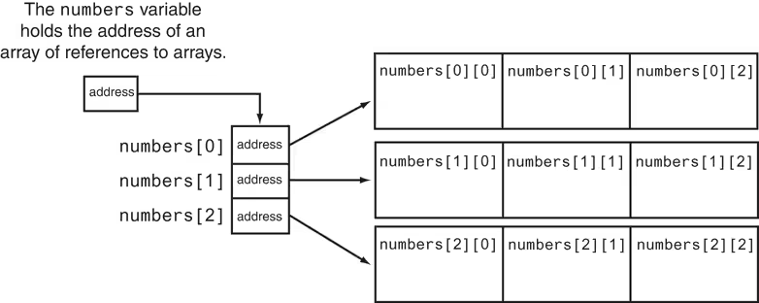
2D Array is Array of Arrays
How do you think 2D Arrays are stored in memory?
How are they passed?
A 2D array is an array of arrays
To get the number of rows in array is use numbers.length
To get the number of columns use numbers[0].length where 0 can be any row

Slide 9
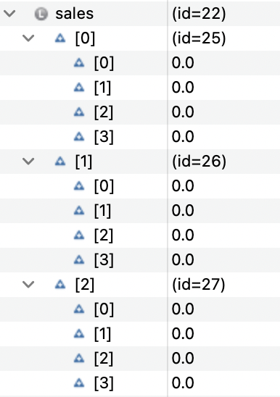
Pair Programming
If you have Eclipse installed see Eclipse Cheat Sheet
Create project for mod01 if you do not have one
Find information on how to add CorpSales.java to your eclipse project
Run debugger to see how 2 Dimensional arrays are stored and how you iterate through 2D array with nested for loop
Add comments
Create method to display contents of sales array
Add comments
Version and back up using github desktop
Create method to calculate and return the array sum of all sales values so you can display sum in main
Add comments
Version and back up.
final int DIVS = 3; // Three divisions in the company
final int QTRS = 4; // Four quarters
// Array to hold the sales for each division, for each quarter.
double[][] sales = new double[DIVS][QTRS];

Slide 10
Explore Instance and Static
One person copy TestBankClassVariables.java and paste into visualizer
1. Which values are different for each account?
2. What value is shared across all accounts?
3. When you change the interestRate, what happens to the balance calculations for all existing accounts?
4. Why do we make interestRate static? Would it make sense for each account to have its own interest rate?
5. Should interestRate always be fixed, or should it sometimes be allowed to change? How could we control that?
Other person copy TestStaticVariables.java and paste into java visualizer
1. What variables are unique to each Student object?
2. How does the totalStudents counter behave as new students are created?
3. Is totalStudents stored once per object or once per class? How do you know?
4. What happens if you try to call getTotalStudents() on the class vs. on an instance? Which way is clearer?
5. Why might it be a good design choice to make totalStudents private + use a getter?
Compare your findings: What’s the difference between the variables in the two classes?

Slide 11
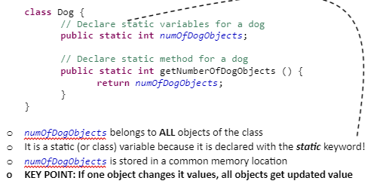
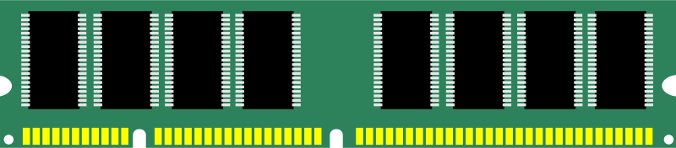
Static (Class) Variables
A variable that IS SHARED by all objects of a class
Fields of a class for which one, and only one, copy exists, regardless of the number of instances of the class
Static Variable also called Class Variable
myDog1.breed
This is not stored on the heap with the instance variable or on the stack
“Bulldog”
0x7fff6771c324
myDog2.name
“Beagle
0x7fff554566

Slide 12


Static (Class) Methods
A method that is shared by ALL objects of a class
It is a static (or class) method because it is declared with the static keyword!
Can be executed without the need to reference a particular instant of the class
This is what is going on in the Math class
Example: Math.sqrt()
Not necessary to have an instance of the class to access this method
Use class name because it makes it clear that the method is static!
Student.getTotalStudents()
BankAccount.setInterestRate(0.07);
Do not call static methods using object reference variable

Slide 13

Static Constants of a Class
Constants of a class are shared by ALL objects of a class
Constants by default use static keyword!
For example the following can be accessed without create an object.
Math.PI is a final static variable in the Math class
Math.pow(base, power);

Slide 14
Static (Class) Variables and Methods
Static (Class) Variable
A variable that is attached to a class rather than to an instance of the class.
Fields of a class for which one, and only one, copy exists, regardless of the number of instances of the class
Static (Class) Method
A method that is attached to a class rather than to an instance of the class
Methods declared as static are class methods
Methods of a class that can be executed without the need to reference a particular instance of the class
Example: The Math class methods are all static! Math.sqrt(), Math.sin(), Math.pow(), etc

Slide 15
Instance vs Static
Instance method: I need an object’s data to do my work.
Static method: I don’t care about any one object, I just use class-level info or parameters.
Feature | Instance Method | Static Method
Belongs to | An object | The class
Call with | Object reference (student1.getName()) | Class name (Student.getTotalStudents())
Can access | Instance + static variables | Only static variables directly
Typical use | Behavior tied to object data | Utility/helper functions, shared operations

Slide 16
Visibility Modifiers
Public
Indicates that the class, method or variable can be accessed from ANY other classes
Can apply to class or members of a class (variables/methods)
Private
Indicates the method or variable can be accessed ONLY from within its own class
Can apply only to members of a class (variables/methods)
Protected
Tied to packages
Default (Package-Private)
Tied to packages
When no modified is specified, default is the visibility
Indicates the class, method, or variable can be accessed by any class within the same package

Slide 17
Static (Class) Variables and Methods Access
An instance method
Can access instance variables and static variables
Can call instance methods and static methods
A static method
Can access static variables
Can access static methods
Cannot access instance variables
Cannot access instance methods
Use instance variables and instance methods when
When each object of the class needs an independent copy of the variable
When instance variables are accessed in methods the method must be an instance method
Use static variables and static methods
When only one copy of the variable is needed and used by all objects
When all objects need to share a variable
When a method is not dependent on a specific instance

Slide 18
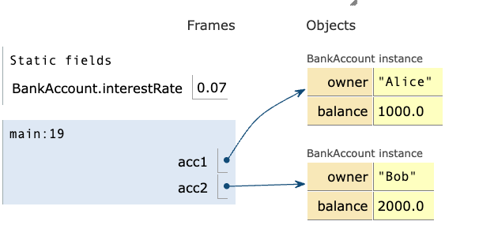
Memory
Stack (method calls / local variables)
Stores local variables inside methods.
Exists only while the method is running.
temporary, per-method call.
Heap (objects & instance variables)
Stores objects created with new.
per-object, instance-specific.
Each object gets its own copy of instance variables.
Class Shared Area (Static)
One copy of static variables and methods for the entire class.
Shared across all objects of that class.

Slide 19

Prepare?
Create study groups
Practice by reviewing examples from lectures class
Run in visualizer or in Eclipse
Edit code
Comment code
Tech Doc - Summarize concepts and include
Snippets of code with comments
Drawing or screenshots (Visualizer or Eclipse IDE) to explain parts of memory
Create your own class and try to do something similar
study-buddies
Go to today’s lecture in canvas:
Class participation and Preparation

